Slide 1
Project in Comparative Genomics
Group 6
Xueqing Wang (Charlotte)
Tianlin He (Tina)

Slide 2
Overview
Identifying the 5 unknown genomes
ORF Finder:
Biological bases
Design
Results
Frequencies
Distance matrix
Constructing the phylogenetic trees

Slide 3
Blasting the 5 given genomes with NCBI genome database
 | Species | Kingdom | Proteome Size
03 | B. thetaiotaomicron | Prokaryote | 4816
08 | D. turgidum | Prokaryote | 1742
09 | E. coli | Prokaryote | 4140
18 | Synechocystis sp. | Prokaryote | 3513
30 | S. cerevisiae (chr. X) | Eukaryote | 405

Slide 4
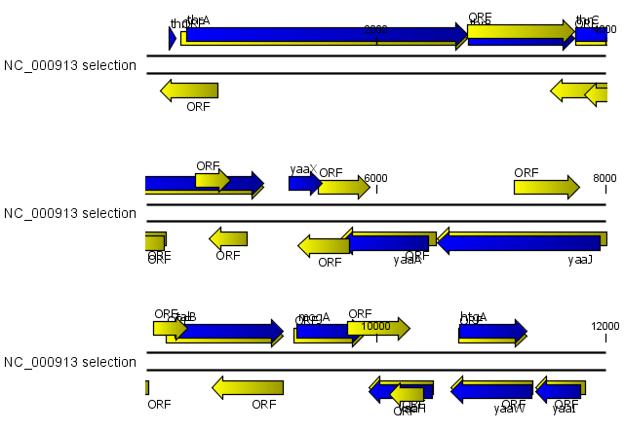
Open Reading Frames Predictor
Start/Stop Codon Recognization
Translation Signals Added
Parameters Adjustment
Result Evaluation
§ All six reading frames on double DNA strands are take into consideration.
->The term “coding strand” is only valid for a specific gene; for the whole genome, all the frames can encode genes.
§ For overlapping ORFs, only the longest one is reserved.
->Overlapping is only valid for the same reading frame; for every overlapping groups, all the ORFs share the same position of stop codon.
§ All the ORFs less than 100 bases long are discarded.

Slide 5
Start/Stop Codon Recognization
Translation Signals Added
Parameters Adjustment
Result Evaluation
Biological Background
TSS
Variable !
Prokaryotes
Eukaryotes
Pribnow Box: -10 upstream of the transcription start site. Consensus sequence TATAAT.
Transcription Signals
-35 upstream of the transcription start site. Consensus sequence TTGACA.
T | A | T | A | A | T
77% | 76% | 60% | 61% | 56% | 82%
Translation Signals
T | T | G | A | C | A
69% | 79% | 61% | 56% | 54% | 54%
“CONSENSUS”: not intact in all promoters!
On average, only 3 to 4 of the 6 base pairs in each consensus sequence are found in any given promoter.

Slide 6
Start/Stop Codon Recognization
Translation Signals Added
Parameters Adjustment
Result Evaluation
Biological Background
SHINE-DALGARNO SENQUENCE
-> Ribosome biting site in messenger RNA.
-> Complementary to the 3’ end of 16S rRNA--base pairing between SD sequence in mRNA and 3' end of 16S rRNA is important for initiation of translation by bacterial ribosomes!
-> The six consensus sequence: AGGAGG, varies in different species (e.g. AGGAGGT in E.coli).
Prokaryotes
Eukaryotes
Transcription Signals
The majority of the putative TSSs were located between 20 to 40 nucleotides from the translational start site.
Translation Signals
Mendoza-Vargas A, Olvera L, Olvera M, Grande R, Vega-Alvarado L, Taboada B, et al. (2009) Genome-Wide Identification of Transcription Start Sites, Promoters and Transcription Factor Binding Sites in E. coli. PLoS ONE 4(10).
Dahlberg A E (1989). "The functional role of ribosomal RNA in protein synthesis". Cell. 57: 525–529.

Slide 7
Start/Stop Codon Recognization
Translation Signals Added
Parameters Adjustment
Result Evaluation
Biological Background
Prokaryotes
The transcription and translation in eukaryotes are more complicated.
--due to the complexity of eukaryotic genome
-> Transcription signals:
Before TSS.
Core promoter: TATA box(binds to general transcription factors, initiates transcription complex assembly)
Regulatory sequences: enhancer, silensor, insulator...
Eukaryotes
Transcription Signals
Translation Signals

Slide 8
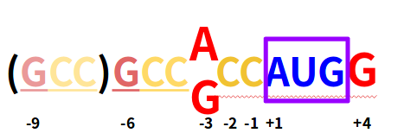
Start/Stop Codon Recognization
Translation Signals Added
Parameters Adjustment
Result Evaluation
Biological Background
KOZAK CONSENSUS SEQUENCE
Prokaryotes
Eukaryotes
Transcription Signals
The Kozak sequence can be simply regarded as the elongation of (GCC) in the upstream of start codon.
The further this triplex is, the weaker effect it has to the initiation of translation (in some organism can be repeated 4-6 times).
A/G (most often A) in position -3 and G in position +4 are dominant.
Translation Signals
Kozak, M. (1987) At least six nucleotides preceding the AUG initiator codon enhance translation in mammalian cells. J. Mol. Biol. 196, 947–50.

Slide 9
Start/Stop Codon Recognization
Translation Signals Added
Parameters Adjustment
Result Evaluation
Prokaryotes:
Searching for consensus sequence upstream of ATG.
-> Consensus sequence: should we use the intact six-base one?
AGGAGGT for E.coli [-50,-2]: only 84 sequences left...
GAGG? (a consensus sequence dominatng in E.coli virus T4 early genes)
-> Where to expect the sequence?
In terms of biological meaning, the Shine-Dalgarno sequence is generally located around 8 bases before the start codon...
GAAGGAATGGGAGAGGCTGCACAGGTTTCTTTCAAAAAATCGATGGAATATATGGGATTCCAGCCGGGTG
increased searching interval until 50 bases upstream of the start codon
Malys N (2012). "Shine-Dalgarno sequence of bacteriophage T4: GAGG prevails in early genes". Molecular Biology Reports. 39 (1): 33–9.

Slide 10
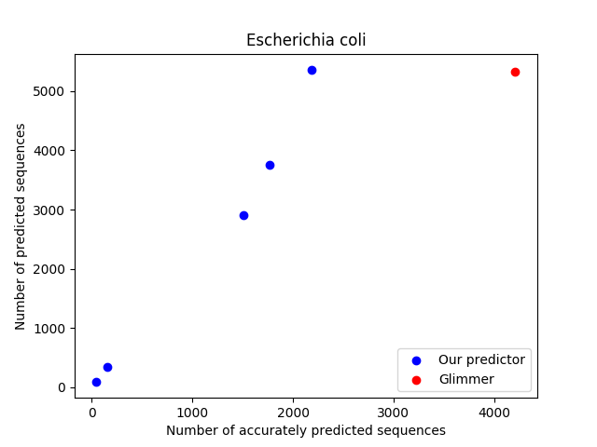

Start/Stop Codon Recognization
Translation Signals Added
Parameters Adjustment
Result Evaluation
Prokaryotes:
 | AGGAGGT [-50,-2] | AGGAGG [-50,-2] | GAGG [-50,-2] | GAGG [-30,-2] | GAGG [-20,-2]
03
08
09
18
§ Our predictor is “outcome-oriented”.
->Instead of sticking to the biological meanings, we extend the variable area of SD sequence and reserve the one with the best output.
Eukaryotes:
Kozak consensus sequence is checked. Only the start codons with A/G at -3 and G at position +4 can start translation (in our program).

Slide 11
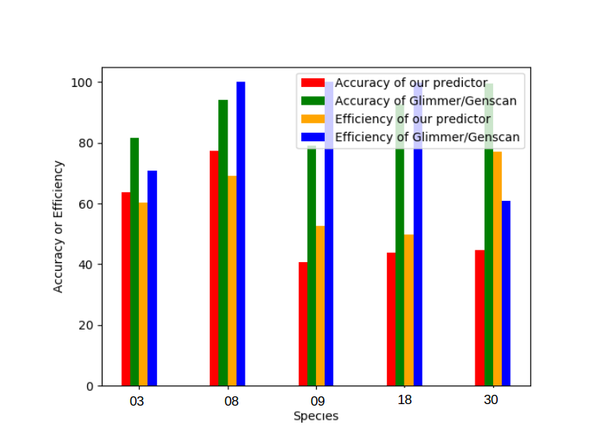
Start/Stop Codon Recognization
Translation Signals Added
Parameters Adjustment
Result Evaluation
Comparison with Glimmer/Genscan:
Accuracy =
Number of accurately predicted ORFs
Total number of ORFs predicted by our predictor:
Number of predicted ORFs in total
Efficiency =
Number of accurately predicted ORFs
Species | 03 | 08 | 09 | 18 | 30
Number of annotated protein sequences in NCBI or UniProt | 4816 | 1742 | 4140 | 3513 | 405
Total number of protein sequences predicted by our predictor | 4577 | 1555 | 5357 | 3992 | 698
Number of peptide sequences in proteome
Accurate predicted ORFs: E-value<10⁻⁵ when running BLAST.
§ Our predictor is not as good as Glimmer/Genscan in terms of both accuracy and efficiency.
§ The results are hard to improve due to the limitation of our signal detecting method; for more accurate prediction, machine learning methods (e.g. HMM, scoring matrices) have to be used.

Slide 12
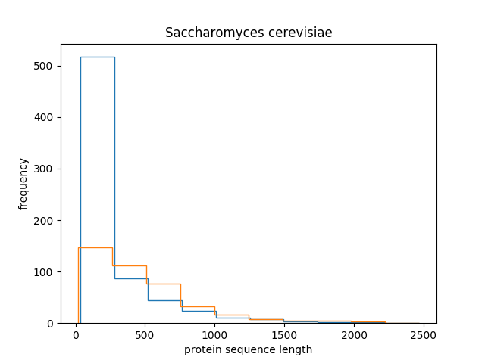
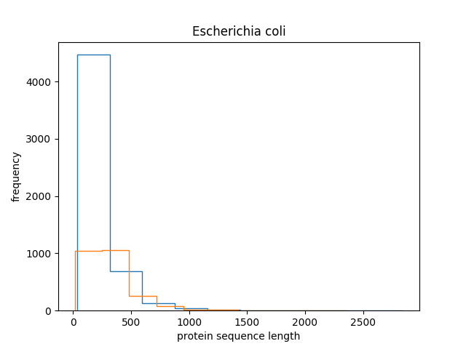

Slide 13
Composition of genomes and proteomes
4 X Nucleotides: A, T, C, G
16 X di-nucleotide: AA, AT,.....GC, GG
GC content
20 X amino acid Ala, Cys,...Tyr
400 X di-amino acids
3 X stop codons TAA, TAG, TGA
genome
ORFs

Slide 14
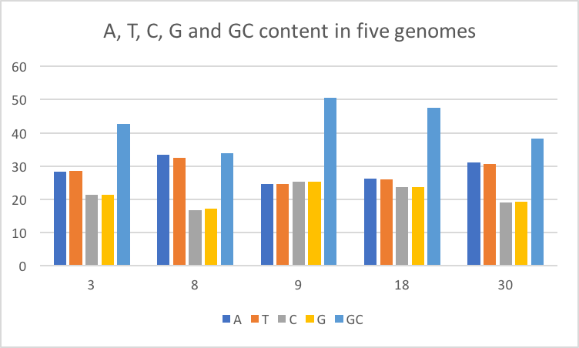
Genome composition
 | 3 | 8 | 9 | 18 | 30
Di-nucleotides
AA | 8.94% | 12.72% | 7.25% | 9.13% | 10.87%
AT | 8.66% | 9.86% | 6.70% | 6.94% | 8.92%

Slide 15
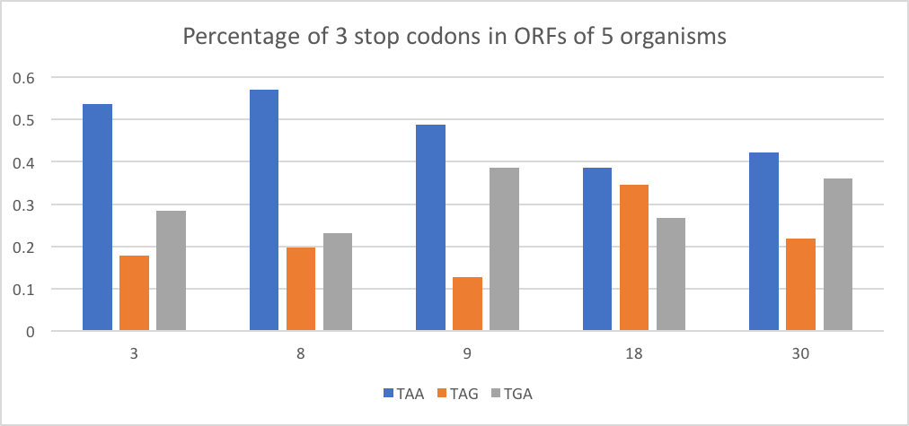
ORF composition
Aminio acids
Ala | 6.7016% | 5.2171% | 9.4490% | 8.3809% | 5.5301%
Cys | 1.2724% | 0.6966% | 1.1551% | 1.0130% | 1.2532%
Di-amino acids
Ala-Ala | 0.517076% | 0.240027% | 0.954983% | 0.671384% | 0.412511%
Ala-Cys | 0.096574% | 0.044423% | 0.115854% | 0.083134% | 0.074948%

Slide 16
Distance matrix
4 X Nucleotides: A, T, C, G
16 X di-nucleotide: AA, AT,.....GC, GG
GC content
20 X amino acid Ala, Cys,...Tyr
400 X di-amino acids
3 X stop codons TAA, TAG, TGA
genome
ORFs
0 <= d(x, y) <= 1
d(x, y) = d(y, x)
d(x, x) = 0

Slide 17
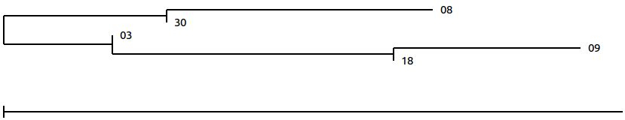
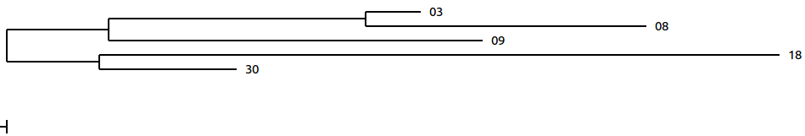
Phylogenetic trees
4 X Nucleotides: A, T, C, G
16 X di-nucleotide: AA, AT,.....GC, GG
GC content
20 X amino acid Ala, Cys,...Tyr
- Our ORF Predictor
- Glimmer/Genscan
3 X stop codons TAA, TAG, TGA

Slide 18

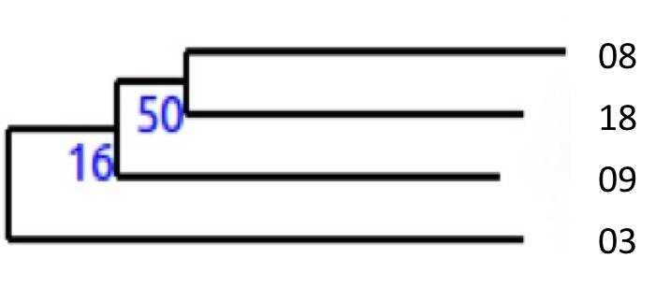
Comparative analysis
from 16s rRNA

Slide 19
Conclusion
Different matrices (nucleotide, amino acid) yields similar tree topology
Consistency with central dogma DNA -> mRNA -> amino acid
Only one matrix is sufficiently representative of genome/proteome composition
But the topology does not agree with results from 16s rRNA
Knowing the genome/proteome composition is not informative enough for phylogenetic study
We need more information about coordination to build the distance matrix: transformation distance...
Multiple sequences alignment - substitution matrix remains the most reliable way for phylogenetic analysis!

